Slide 1
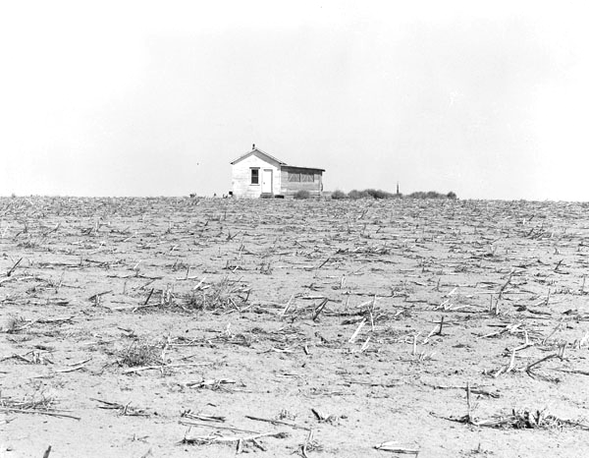
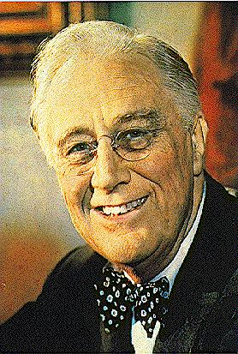
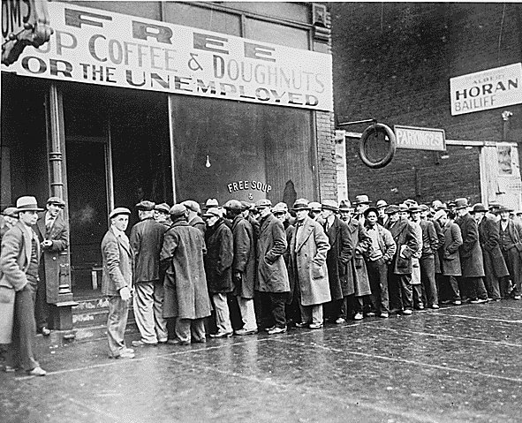
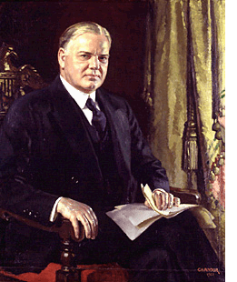
Review Exercise on the 20’s and 30’s
By:
Matt Olan
Lauren Litchet
Lu Romero
Kayleigh Allen

Slide 2
Four Reasons for the Depression
1. Stock Market Crash of 1929
Many believe erroneously that the stock market crash that occurred on Black Tuesday, October 29, 1929 is one and the same with the Great Depression. In fact, it was one of the major causes that led to the Great Depression. Two months after the original crash in October, stockholders had lost more than $40 billion dollars. Even though the stock market began to regain some of its losses, by the end of 1930, it just was not enough and America truly entered what is called the Great Depression
2. Bank Failures
Throughout the 1930s over 9,000 banks failed. Bank deposits were uninsured and thus as banks failed people simply lost their savings. Surviving banks, unsure of the economic situation and concerned for their own survival, stopped being as willing to create new loans. This exacerbated the situation leading to less and less expenditures.
3. Reduction in Purchasing Across the Board
With the stock market crash and the fears of further economic woes, individuals from all classes stopped purchasing items. This then led to a reduction in the number of items produced and thus a reduction in the workforce. As people lost their jobs, they were unable to keep up with paying for items they had bought through installment plans and their items were repossessed. More and more inventory began to accumulate. The unemployment rate rose above 25% which meant, of course, even less spending to help alleviate the economic situation.
4. American Economic Policy with Europe
As businesses began failing, the government created the Smoot-Hawley Tariff in 1930 to help protect American companies. This charged a high tax for imports thereby leading to less trade between America and foreign countries along with some economic retaliation.
5. Drought Conditions
While not a direct cause of the Great Depression, the drought that occurred in the Mississippi Valley in 1930 was of such proportions that many could not even pay their taxes or other debts and had to sell their farms for no profit to themselves. This was the topic of John Steinbeck's The Grapes of Wrath.

Slide 3
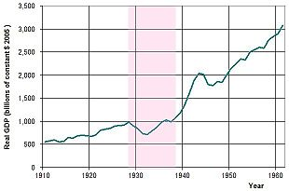
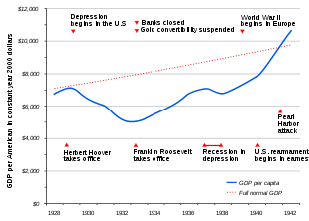
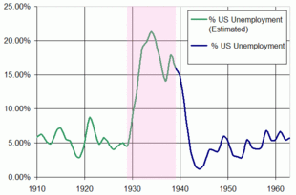
Charts that display economic downturn

Slide 4
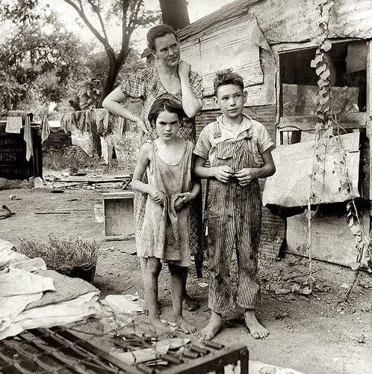
Conditions of the Depression

Slide 5
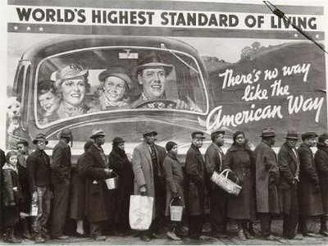
Conditions of the Depression

Slide 6
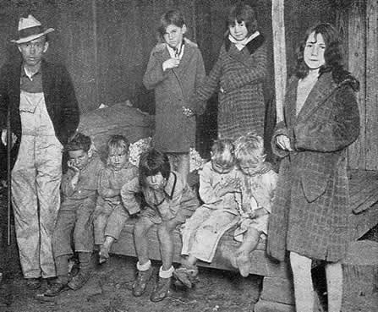
Conditions of the Depression

Slide 7
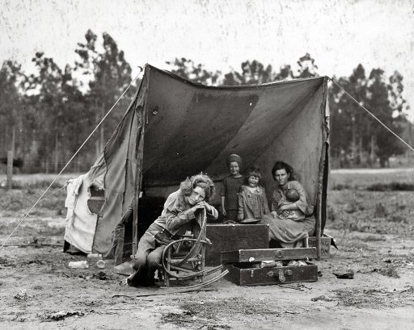
Conditions of the Depression

Slide 8
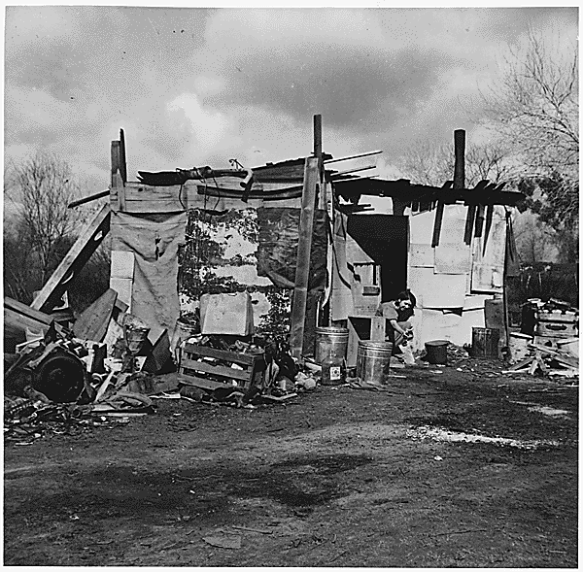
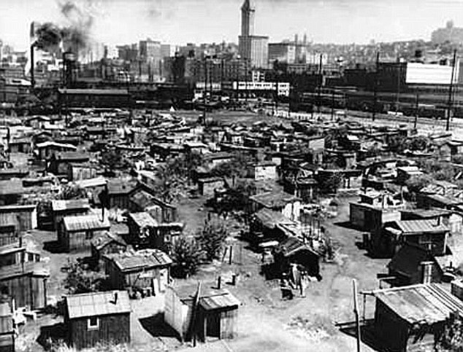
Conditions of the Depression

Slide 9

Songs of the Depression
“Brother, Can You Spare a Dime," lyrics by Yip Harburg, music by Jay Gorney (1931)
They used to tell me I was building a dream, and so I followed the mob,
When there was earth to plow, or guns to bear, I was always there right on the job.
They used to tell me I was building a dream, with peace and glory ahead,
Why should I be standing in line, just waiting for bread?
Once I built a railroad, I made it run, made it race against time.
Once I built a railroad; now it's done. Brother, can you spare a dime?
Once I built a tower, up to the sun, brick, and rivet, and lime;
Once I built a tower, now it's done. Brother, can you spare a dime?
Once in khaki suits, gee we looked swell,
Full of that Yankee Doodly Dum,
Half a million boots went slogging through Hell,
And I was the kid with the drum!
Say, don't you remember, they called me Al; it was Al all the time.
Why don't you remember, I'm your pal? Buddy, can you spare a dime?
Once in khaki suits, gee we looked swell,
Full of that Yankee Doodly Dum,
Half a million boots went slogging through Hell,
And I was the kid with the drum!
Say, don't you remember, they called me Al; it was Al all the time.
Say, don't you remember, I'm your pal? Buddy, can you spare a dime?

Slide 10
Songs of the Depression
"Life is Just a Bowl of Cherries," lyrics by Lew Brown, music by Ray Henderson (1931)
People are queer, they're always crowing, scrambling and rushing about;
Why don't they stop someday, address themselves this way?
Why are we here? Where are we going? It's time that we found out.
We're not here to stay; we're on a short holiday.
Life is just a bowl of cherries.
Don't take it serious; it's too mysterious.
You work, you save, you worry so,
But you can't take your dough when you go, go, go.
So keep repeating it's the berries,
The strongest oak must fall,
The sweet things in life, to you were just loaned
So how can you lose what you've never owned?
Life is just a bowl of cherries,
So live and laugh at it all.
Life is just a bowl of cherries.
Don't take it serious; it's too mysterious.
At eight each morning I have got a date,
To take my plunge 'round the Empire State.
You'll admit it's not the berries,
In a building that's so tall;
There's a guy in the show, the girls love to kiss;
Get thousands a week just for crooning like this:
Life is just a bowl of . . . aw, nuts!
So live and laugh at it all!

Slide 11
Statistics that support the Depression
Statistics
1933, the country's GNP had fallen to barely half its 1929 level
Industrial production fell by more than half, and construction of new industrial plants fell by more than 90%
Production of automobiles dropped by two-thirds
Steel plants operated at 12% of capacity
Herbert Hoover's presidency, more than 13 million Americans lost their jobs. Of those, 62% found themselves out of work for longer than a year; 44% longer than two years; 24% longer than three years; and 11% longer than four years
Unemployment peaked at a staggering 24.1% in 1933, and never dropped below 14.3% until World War II
80% decline in the value of the stock market
1929 and 1933, two out of every five banks in America collapsed

Slide 12
Depression Era Terms
Deserving poor
people who were physically sick and were unable to work and were therefore poor
Charitable standards of the rich regarded them as “deserving”
Evictions
was so common that children in Philadelphia made a game of it
Philadelphia relief paid for evicted families rent for one month in a new house
Landlords often let rent go because they needed relief
Starvation conditions
people starved to death and there were 29 deaths from starvation in 1933
an additional 110 children died of mal nutrition
Health surveys were made to prove the fact that poor people were sicker than the rich
Social workers warned that privation was ruining the nation’s health
1933 the Children’s bureau reported that 1 in 5 US children were not getting the nutrients they needed

Slide 13
Depression Era Terms
Survival tactics
The poor survived because they knew how to be poor
The savvy poor would stay in bed to conserve calories and would eat parts of animals that were typically discarded
A family with no money would economize by cooking once a week to warm the house
When fuel for the furnace was low, they would sneak into a movie house
The poor would take their shoes off in order to save them on their walk home from work
Do-it-yourself shoe-repair kits were popular in the middle class
Hoover policies
plan to reform the nation's regulatory system, believing that a federal bureaucracy should have limited regulation over a country's economic system
saw the presidency as a vehicle for improving the conditions of all Americans by encouraging public-private cooperation—what he termed "volunteerism"
expanded civil service coverage of Federal positions, canceled private oil leases on government lands, and by instructing the justice department and the internal revenue service to pursue gangsters for tax evasion
advocated tax reduction for low-income Americans (not enacted); closed certain tax loopholes for the wealthy
wrote a Children's Charter that advocated protection of every child regardless of race or gender
created an antitrust division in the justice department

Slide 14
Depression Era Terms
Problems of the Rich:
Big Businessmen decided to go along with the if-I-can’t-see-it-it-cant-see-me plan of approach to the Depression.
“don’t emphasize hard times, and everything will be alright.”
Problems of the Middle Class:
Many professionals, such as doctors and dentists, went out of business since they would not accept any patients without monetary payment. Also, many would rather kill themselves than accept public relief.
Other middle class members who were better off had funded private charities for the unemployed, but soon their money also ran out and they were forced to remove their contributions.
African American Conditions:
African Americans during the Great Depression survived better than the “new poor” since they had already been poor their entire lives.
Only a few African Americans would reside in Hoovervilles while the majority of this population were whites.

Slide 15
Depression Era Terms
Poor Conditions:
Those lucky enough to have not been yet evicted from their homes would live in poverty; the houses would have been in dire need of repair, usually the kitchen was the only warm room in the house, the exterior and interior would be covered with dust brought in by dust storms, their clothes would be torn and dirty, and their physical appearance would resemble that of a ghost- pale, and sickly.
For the unemployed who lived in Hoovervilles, their housing would have been crude structures with no running water, electricity, or public sewer systems. Many of these houses and tents would have been located near latrines and cesspools with added to the overall unsanitary conditions of these “Hoovervilles.” The lucky few would be seasonally employed in the canneries, the fruit ranches, and/or the hop fields.
Types of Help Offered:
John B. Nichlos’s Leftover System of Food.
President’s Organization for Unemployment (POUR).
Private and Local (City) Charities.
Public Relief.

Slide 16
Depression Era Terms
City Life
“This picture is so grim that whatever words I use will seem hysterical and exaggerated. And I find them all in the same shape - fear, fear driving them into a state of semi-collapse cracking nerves; and an overpowering terror of the future.... They can't pay rent and are evicted. They are watching their children grow thinner and thinner; fearing the cold for children who have neither coats nor shoes; wondering about coal.” - Martha Gellhorn, director of the Civil Works Administration
Rural Life
"No one had any money. We were all in the same boat."
In the early 1930s prices dropped so low that many farmers went bankrupt and lost their farms
Some farm families began burning corn rather than coal in their stoves because corn was cheaper
In Le Mars, Iowa, a mob of angry farmers burst into a court room and pulled the judge from the bench. They carried him out of the court room, drove him out of town and tried to make him promise that he would not take any more cases that would cost a farm family its farm. When he refused, they threatened to hang him

Slide 17
Depression Era Terms
Dust Bowl
With the onset of drought in 1930, the over farmed and overgrazed land began to blow away. Winds whipped across the plains, raising billowing clouds of dust. The sky could darken for days, and even well-sealed homes could have a thick layer of dust on the furniture
Nineteen states in the heartland of the United States became a vast dust bowl. With no chance of making a living, farm families abandoned their homes and land, fleeing westward to become migrant laborers
Eating Tight
During the Depression, entire neighborhoods were living day by day sharing their resources
8 % of these families were subsisting on one meal a day
37% of all families were not getting the normal three meals a day
4 families had absolutely no solid food whatsoever

